Slide 1
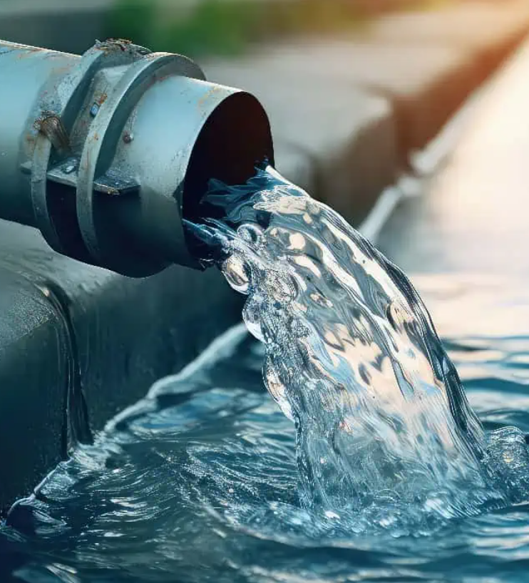
11/11/25
Fluid Flow in Pipes
Angelica Ramirez, Hiba Naqvi, Jazmin Aca, Srija Bomma

Slide 2
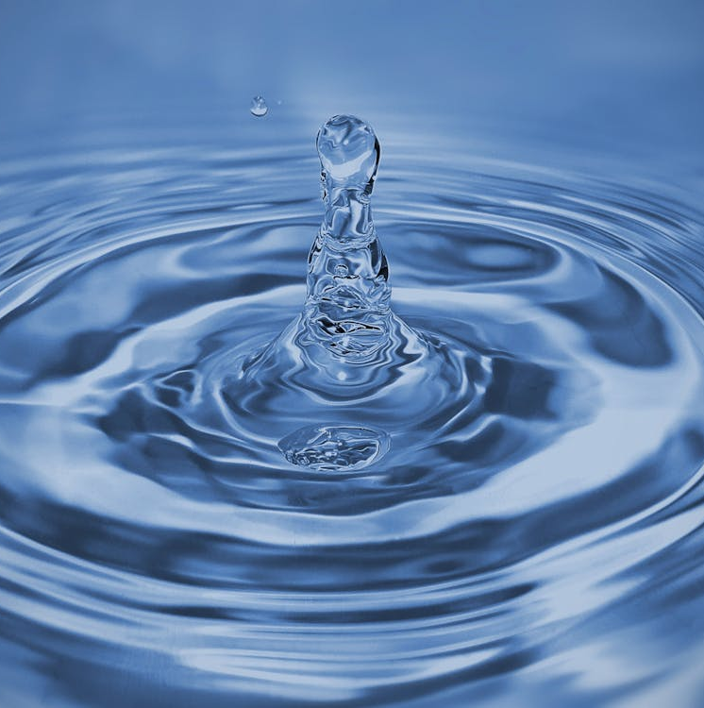
Table of Contents
Introduction
Theory
Apparatus
Materials and Supplies
Procedure
Dangers
Challenges

Slide 3
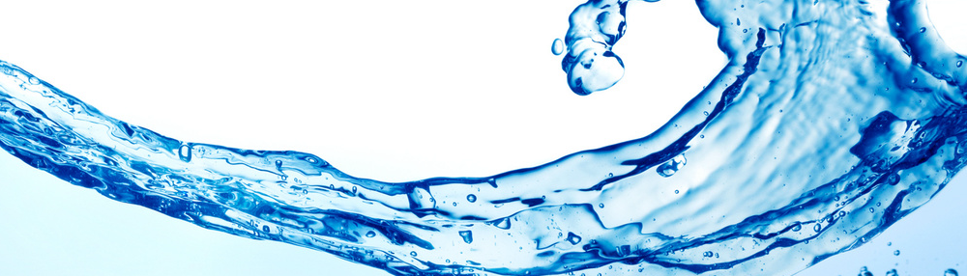
Introduction
The objective of this experiment is to investigate the flow behavior of water through various pipe materials and fittings using the Hampden H-6920 Pipe Friction Demonstrator. This is done by measuring pressure drops across straight pipes and fittings at different flow rates and the experiment aims to determine key parameters such as the friction factor (f), loss coefficient (K), and flow coefficient (Cₓ).

Slide 4
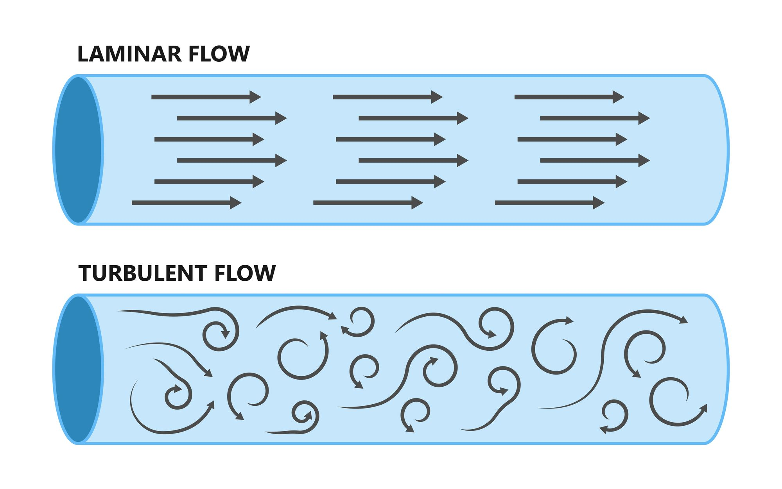
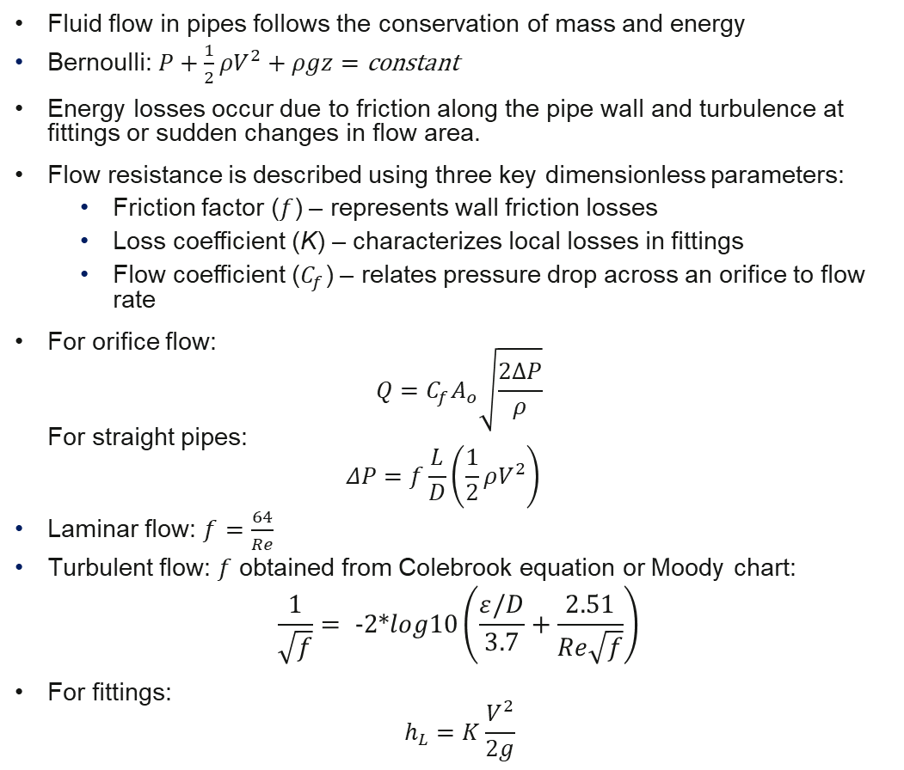
Theory
Fluid flow in pipes follows the conservation of mass and energy
Bernoulli: $P+\frac{1}{2}ρV^{2}+ρgz=\text{constant}$
Energy losses occur due to friction along the pipe wall and turbulence at fittings or sudden changes in flow area.
Flow resistance is described using three key dimensionless parameters:
Friction factor ($f$) – represents wall friction losses
Loss coefficient (K) – characterizes local losses in fittings
Flow coefficient ($C_{f}$) – relates pressure drop across an orifice to flow rate
For orifice flow: $Q=C_{f}A_{o}\sqrt{\frac{2ΔP}{ρ}}$ For straight pipes: $ΔP=f\frac{L}{D}\left(\frac{1}{2}ρV^{2}\right)$
Laminar flow: $f=\frac{64}{Re}$
Turbulent flow: $f$ obtained from Colebrook equation or Moody chart:
$$\frac{1}{\sqrt{f}}= −2∗log10\left(\frac{ε/D}{3.7}+\frac{2.51}{Re\sqrt{f}}\right)$$
For fittings: $h_{L}=K\frac{V^{2}}{2g}$

Slide 5
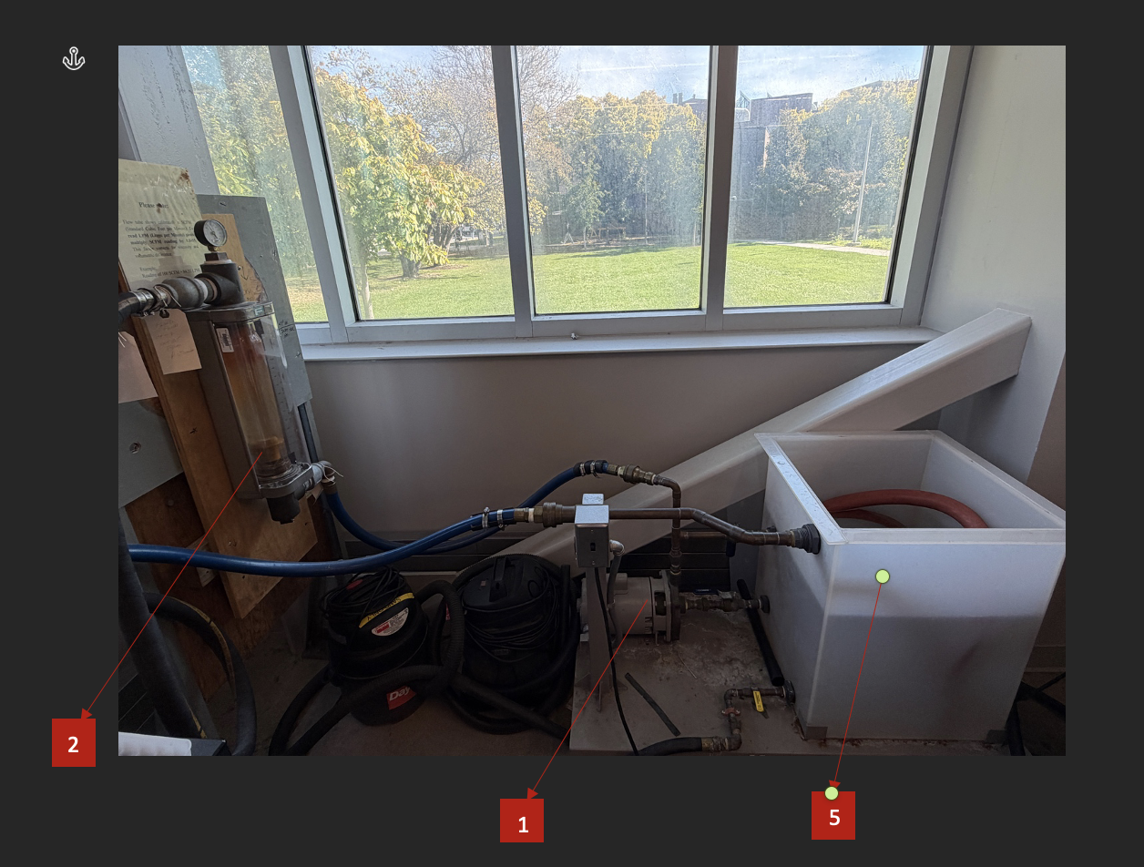
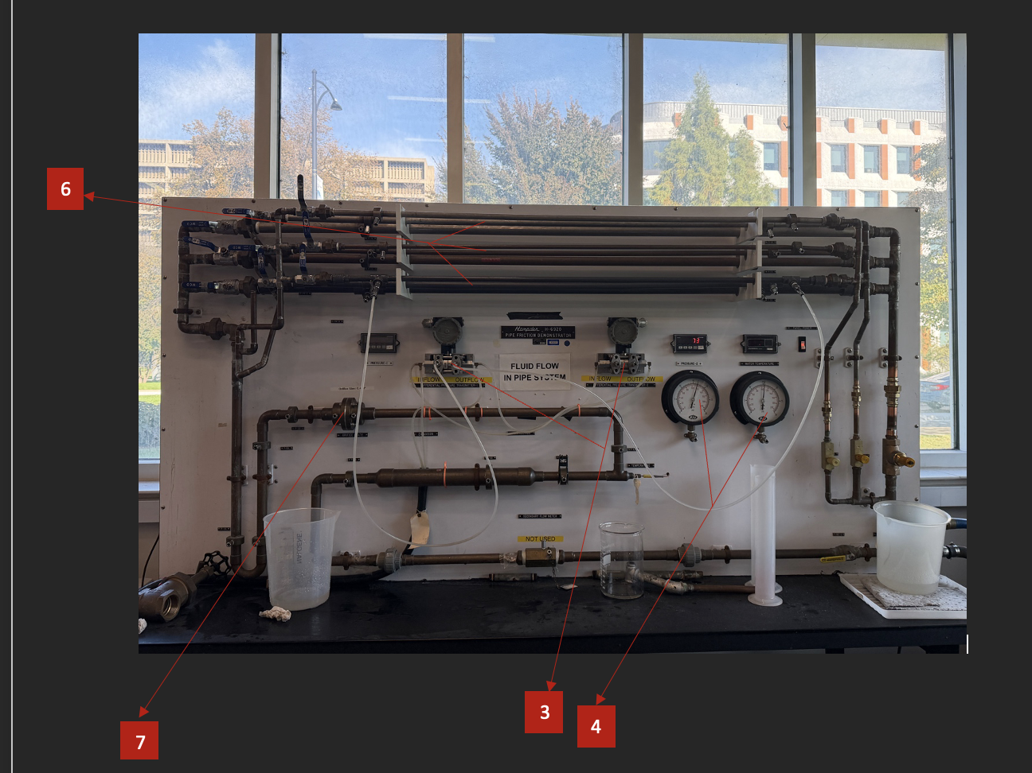
Apparatus
Rotameter: Flow measuring device (calibrated in SCFM for air)
Centrifugal pump: Recirculates water through the system
Water reservoir tank: Storage tank connected to the pump
Straight Pipes (Copper, Plastic, Stainless Steel) : ½”, ¾”, 1” diameters
Orifice Flowmeter: Orifice plate (0.478” diameter) with pressure taps
Differential Pressure Transmitters (DPTs): Two digital transmitters connected via pressure taps
Manual pressure gauges: Analog backup pressure measurement devices
Pipe Fittings: expansion, contraction, Tee, 90° Elbow, 180° Bend
1
2
3
4
8
5
6
7

Slide 6
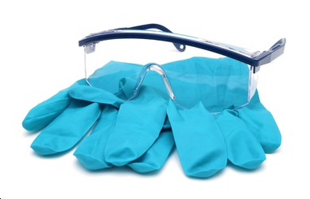
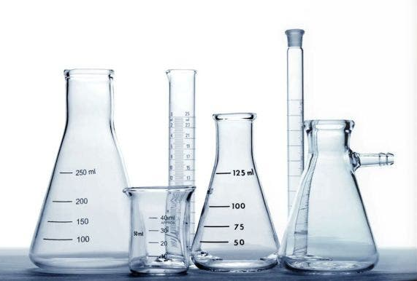
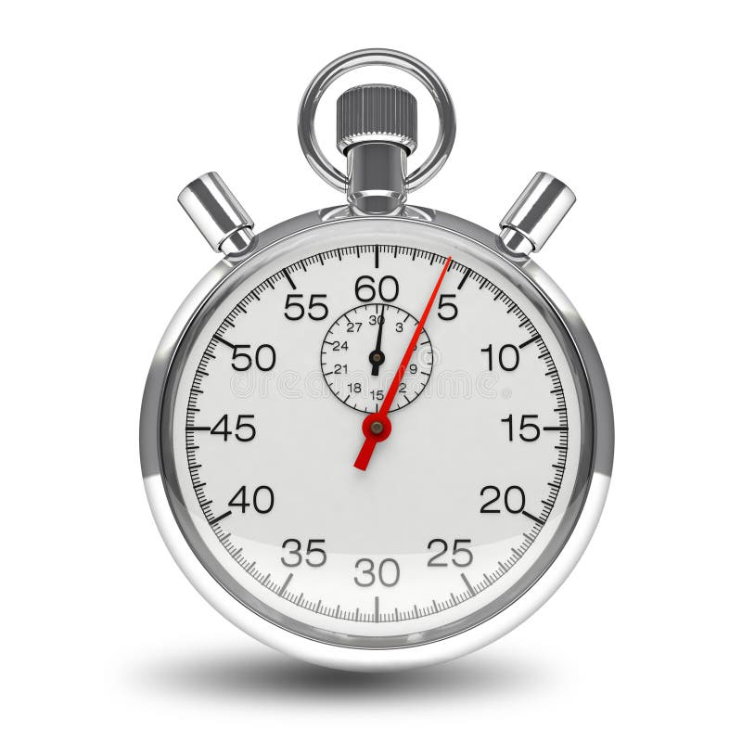
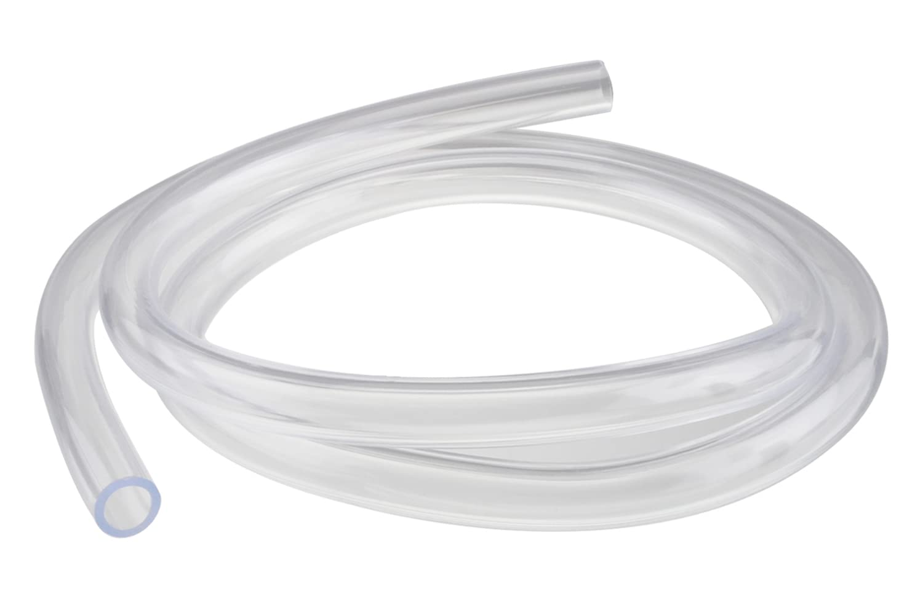
Materials and Supplies
Water
Timer
Graduated cylinder
Flexible plastic tubing
Safety Goggles

Slide 7

Rotameter Calibration
Set the flow to a minimum rate and record the rotameter reading.
Collect water in a graduated cylinder; measure volume (V) and time (t) to calculate flow rate (F = V/t).
Record water temperature (T) for density or viscosity corrections.
Perform five trials, increasing flow from 10 SCFM to 30 SCFM.
Calculate the correction factor.
Orifice Flowmeter Test
Connect pressure taps across the orifice plate (high side = upstream, low side = downstream).
Adjust flow to 10 SCFM and measure differential pressure (ΔP) and temperature (T).
Repeat measurements at 10, 15, and 20 SCFM.
Pipe Friction Head Loss
Select straight pipe sections (copper, plastic, or stainless steel).
Connect DPT pressure taps on both sides of the pipe.
Adjust flow to 10 SCFM; record ΔP and T.
Repeat for flow rates of 10, 15, and 20 SCFM and for three different pipe sizes.
Pipe Fitting Head Loss
Choose fittings such as 90° elbow, 180° bend, expansion, or contraction.
Join DPT between the fitting’s pressure ports.
Record ΔP and T at various flow rates (3 trials per fitting).
Purge air from pressure lines before each test to ensure accuracy.
Repeat for all fittings under the same flow conditions.
Procedure

Slide 8
Dangers
SYSTEM leaks water so avoid having any electronic devices on the table
Do not run the pump without water

Slide 9
Challenges
Pressure Drop Readings can fluctuate due to small ΔP values and instrument sensitivity.
Tubing leaks throughout the experiment so ensure to maintain a container to catch the water and prevent flooding of the bench table
Record data carefully across multiple materials and fittings to simplify post-lab analysis.

